Slide 1
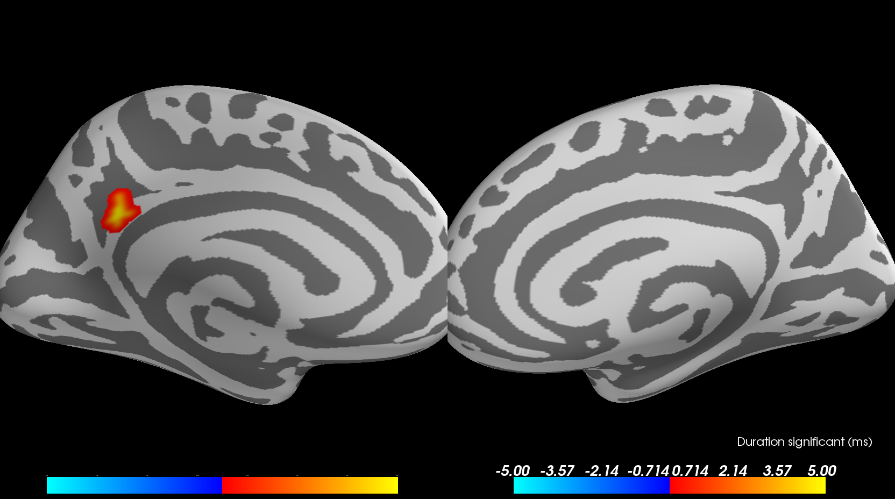
Tutorial - Source reconstruction using mne-python
August 2017 - A. Pasmantier

Slide 2
Introduction
The work presented here realises source reconstruction and source-space cluster statistics from a raw file (.ds) in 7 relatively easy steps.
Each step uses at least one python (amongst others) script generating data files that might be useful/mandatory for the next steps, thus the importance of following the order given in this document.
The integrality of this work relies on 9 python scripts, a .csv file and a Matlab program : 1: header.py, 2 : preproc_alex.py, 3 : plot_evokeds.py, 4 : source_rec_pre.py, 5 : HPI_update.py, 6 : covariance_matrix.py, 7 : src_rec.py, 8 : morphing-stc.py, 9 : spatio-temp-cluster-test.py + Adjust_Head_Pos (matlab program) + listdata.csv

Slide 3
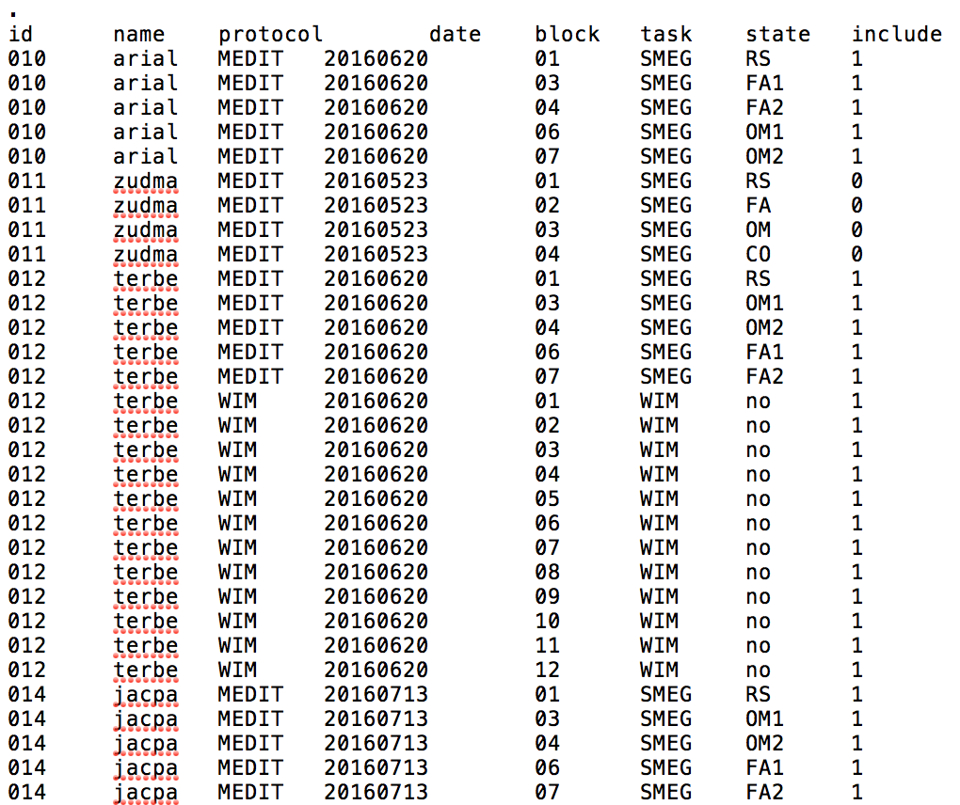
Before we start
Make sure to complete the .csv file « listdata.csv » located in the « meta » directory.
Every column should be separated by a tabulation character.
The first line (with the dot) should be left as is due to a bug when importing csv files with panda.
« listdata.csv »

Slide 4
0. header.py
This file contains all the imports required and is imported in a single line in every other script.
NB : some imports are abbreviated, e.g. os.path as op
Environment variables (e.g. for FreeSurfer) and base paths (e.g. Analysis_path) are also defined there.

Slide 5
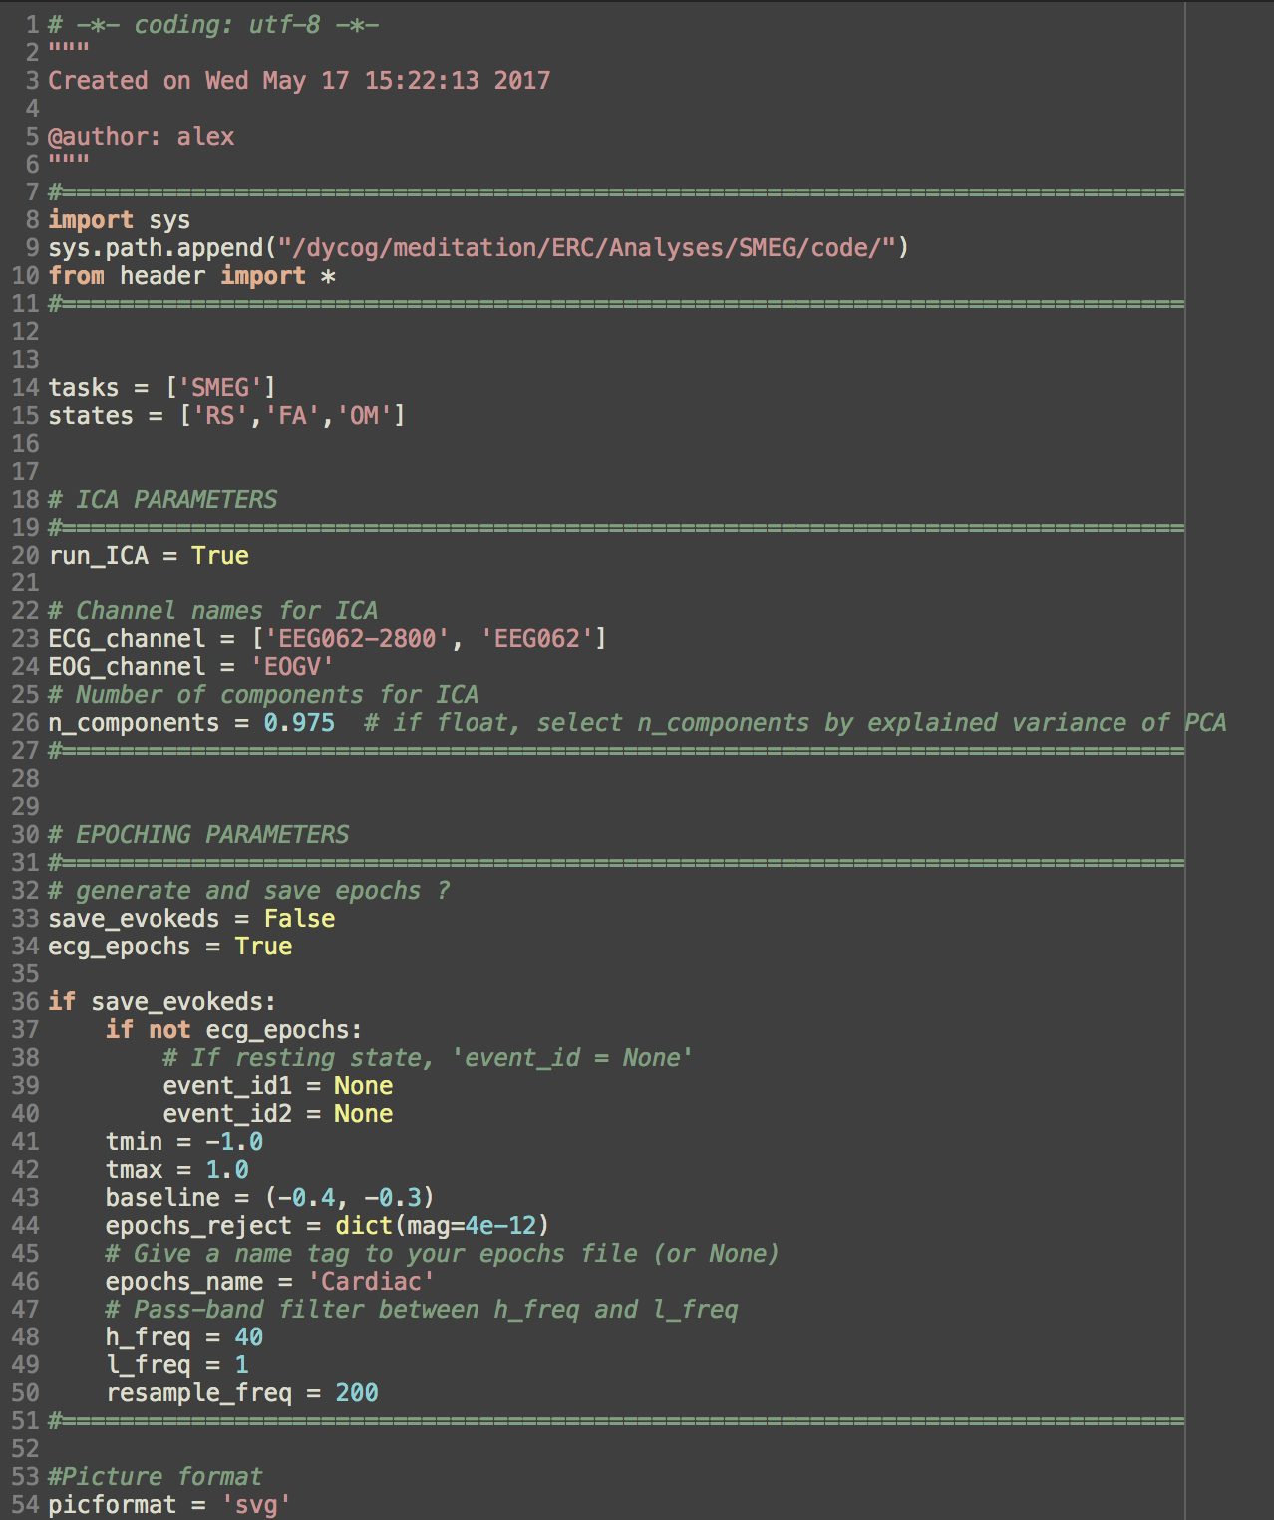
1. Preprocessing
Open « preproc_alex.py »
Specify the different parameters : tasks, states, ICA PARAMETERS, EPOCHING PARAMETERS, and picformat. NB : ‘ecg_epochs' is used for heartbeat-related responses. You can leave it as ‘False’ if this isn’t what you’re looking for.
Run the script.
If run_ICA = True, you should now have the corresponding -ica.fif files in your ICA directory along with 3 .svg files per .fif file to check it. If save_evokeds = True, you should now have the evoked files as -ave.fif files in the evoked directory.
You can now check all your output data (evokeds and ICA) using « plot_evokeds.py » : Specify the parameters you want (i.e. ‘REM = [‘True’] to plot ERFs removing ecg artifacts).
« preproc_alex.py »

Slide 6
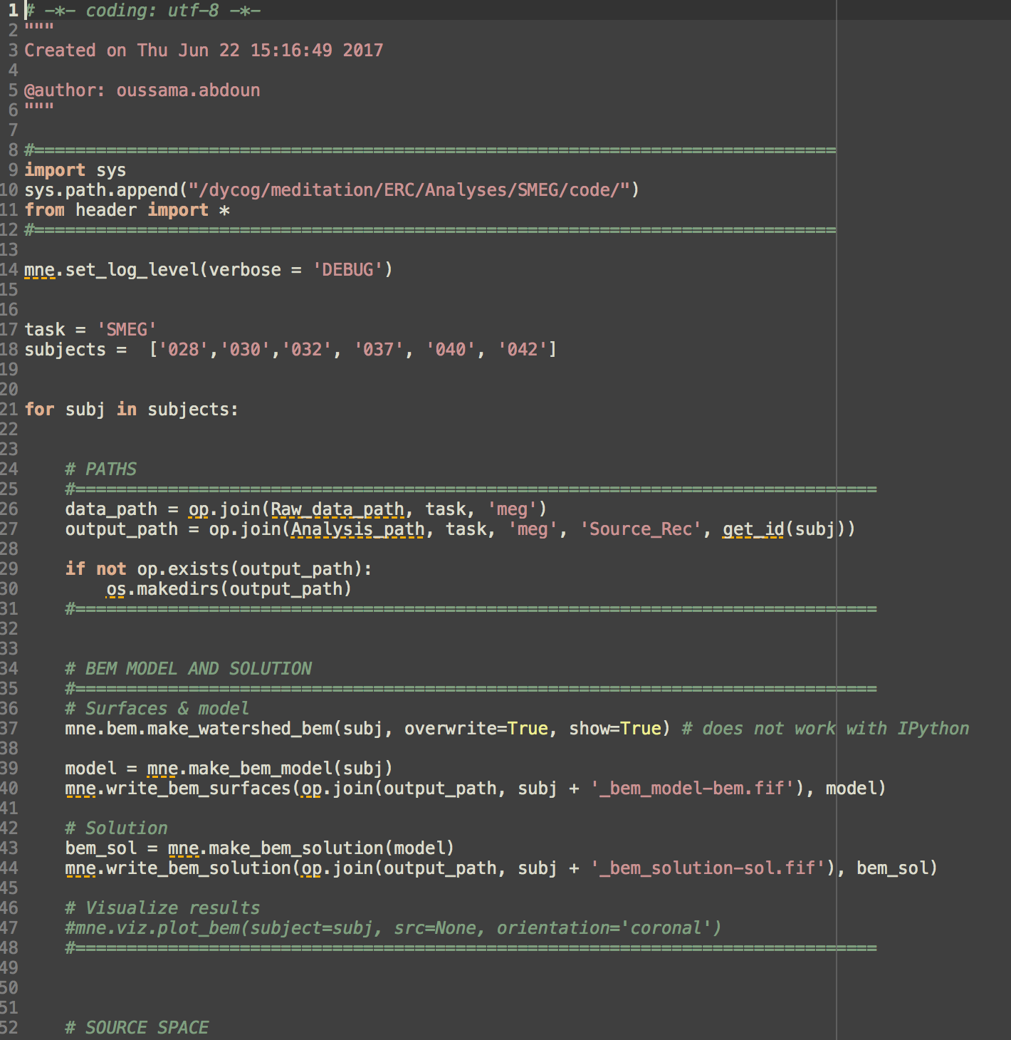
2. Preparing BEM model and source space
Open « source_rec_pre.py »
Fill out ‘task’ and ‘subjects’ parameters. NB : to process all subjects for this task, just specify : subjects = get_subjlist(task)
In the ‘SOURCE SPACE’ section, change ‘spacing’ parameter if needed.
Run the script.
You should now have 3 new files in your subject’s ‘Source_Rec’ directory, each ending with ‘-bem.fif’, ‘-sol.fif’ and ‘-src.fif’.
« source_rec_pre.py »

Slide 7
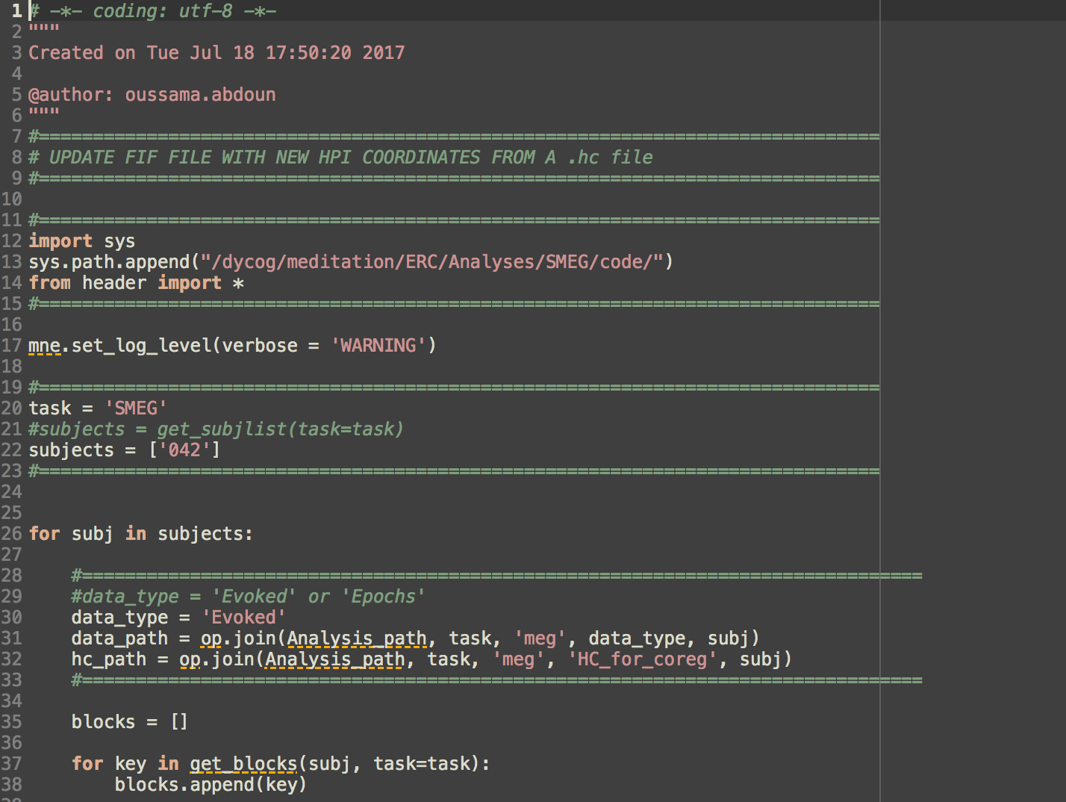
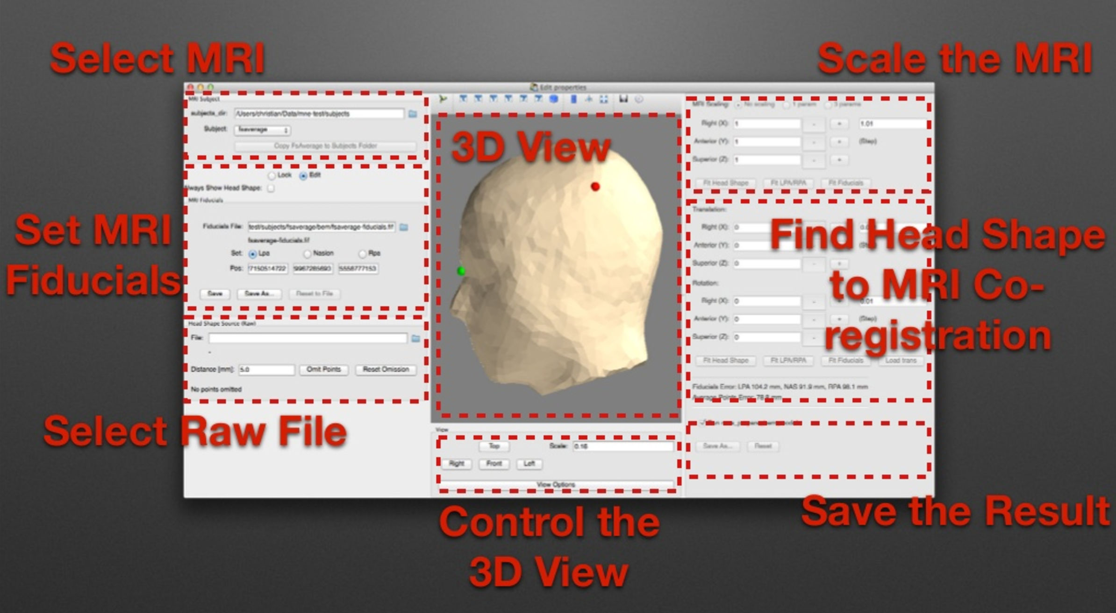
3. Coregistration
Open the Matlab script ‘Adjust_Head_Pos_3DirbyCoil.m’ and run it. *COMPLETE LATER* Save the .hc files according to the blocks you merged.
Open « HPI_update », fill out the required parameters (task, subjects, data_type) and run the script. All your evoked files are now updated with your new .hc files.
Open a new Python console and run the « header.py » file. In the same console, run the command line : “%gui wx“, followed by “mne.gui.coregistration()“ : a new window should open.
Follow the steps described in this tutorial : https://www.slideshare.net/mne-python/mnepython-coregistration and save according to the .hc filename.
You should now have several ‘-trans.fif’ files corresponding to the coregistrations you saved in your subject’s ‘Source_Rec’ directory.
« HPI_update.py »
« mne.gui.coregistration() »

Slide 8
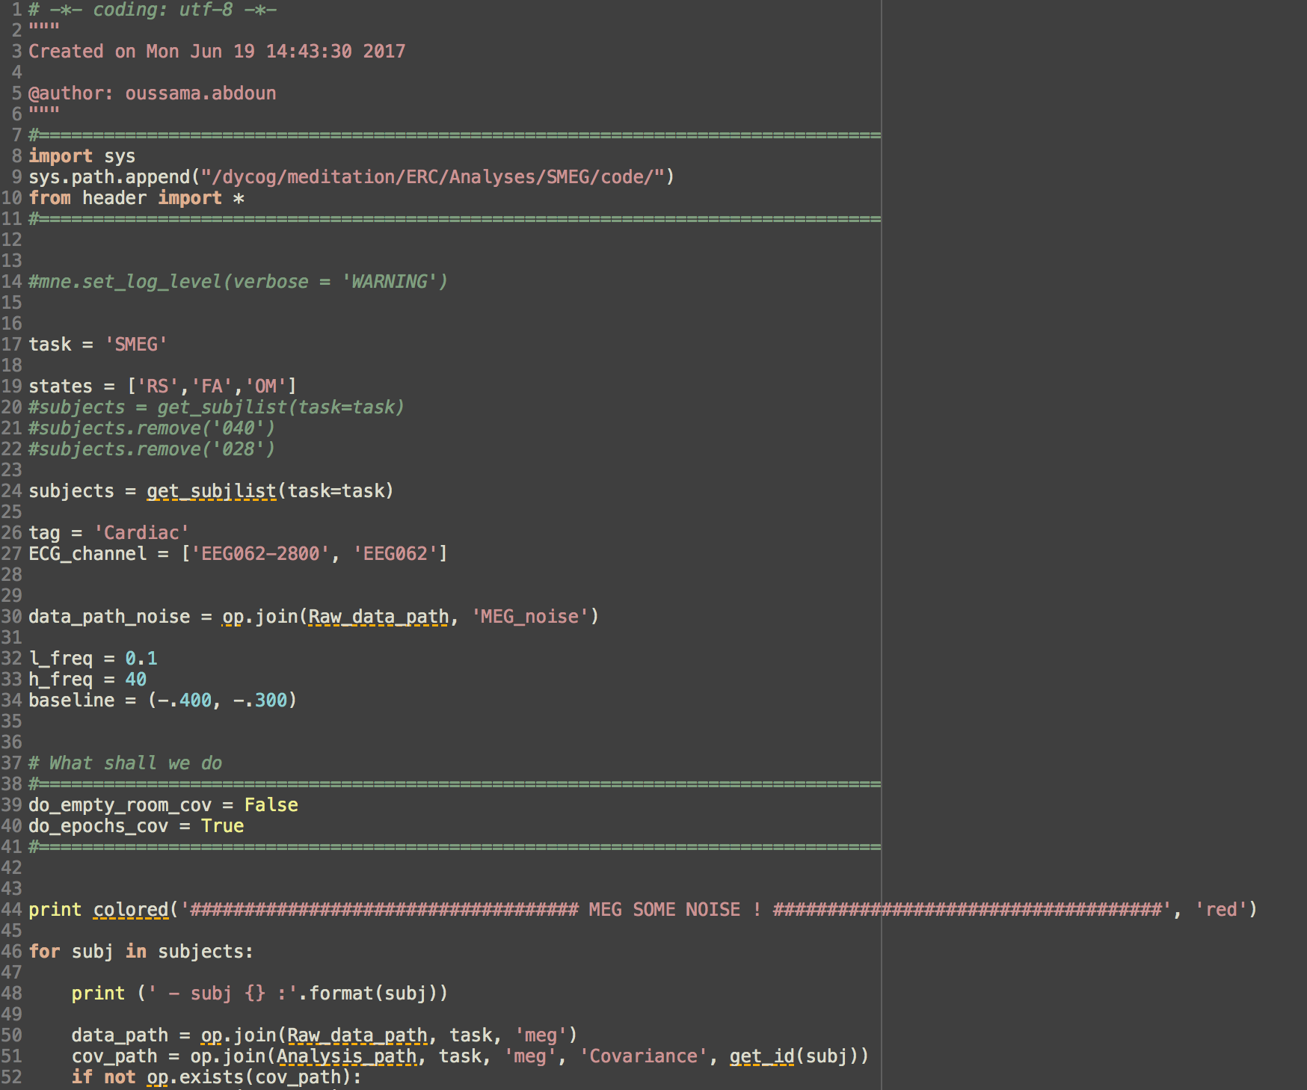
4. The covariance matrix
Open « covariance_matrix.py »
Specify the different parameters : task, states, subjects, tag (corresponding to the evoked series you want to process, for example ‘Cardiac’), etc. NB : the ‘EPOCHS BASELINE NOISE COVARIANCE’ needs rewriting/completing to be able to process any type of evoked (not just cardiac).
Specify whether you want empty room covariance or epochs baseline covariance setting do_empty_room_cov and do_epochs_cov
Run the script.
You should now have the corresponding ‘-cov.fif’ files in your subject’s ‘Covariance’ directory.
« covariance_matrix.py »

Slide 9
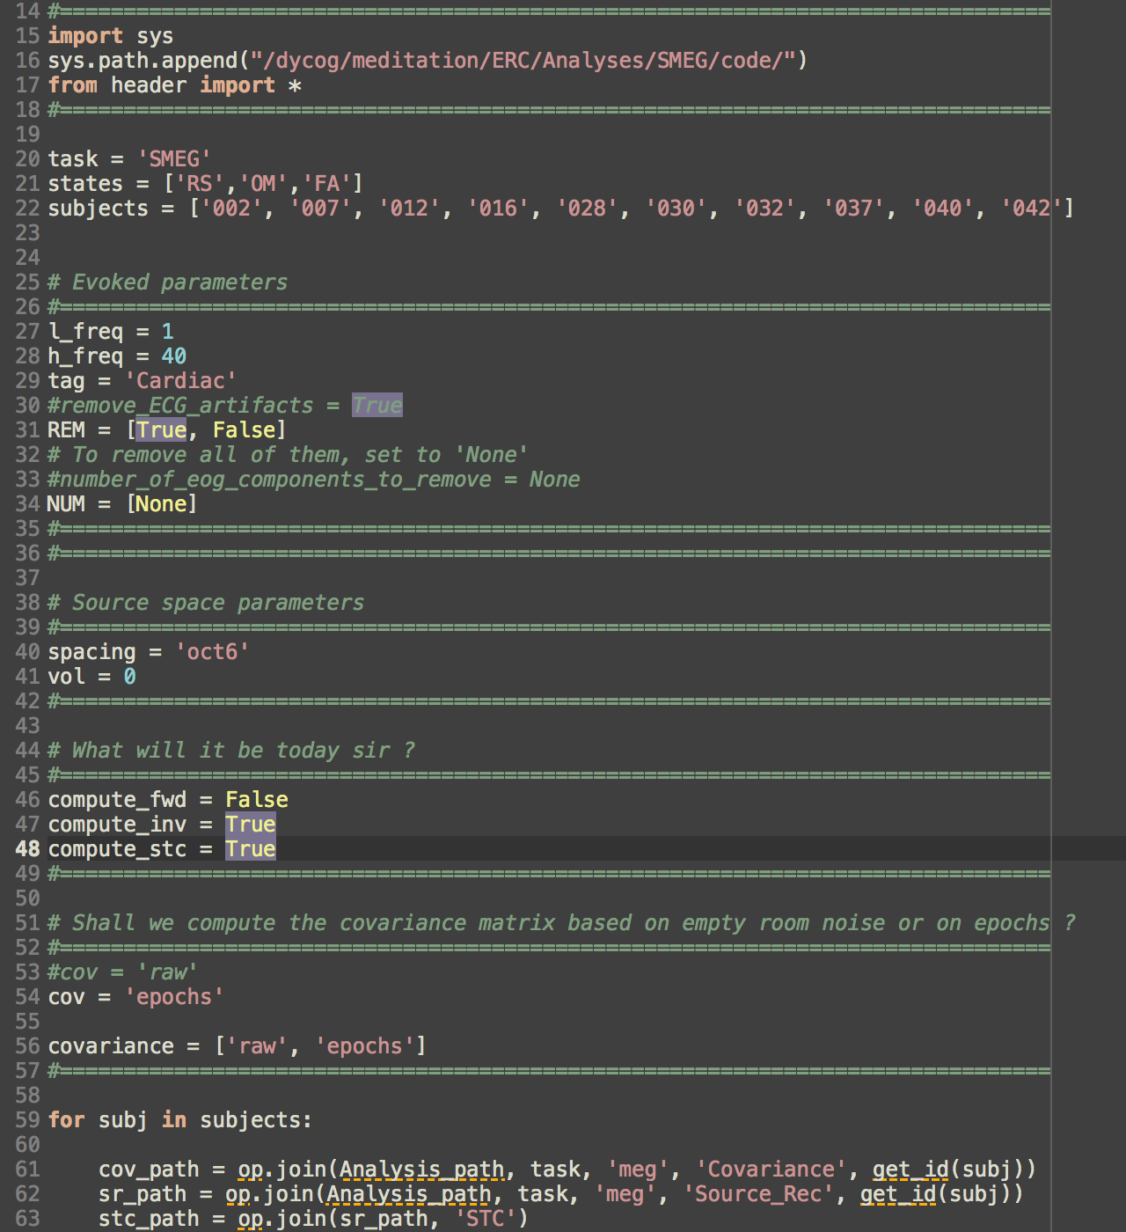
5. Source reconstruction
Open « src_rec.py »
Specify the general parameters task, states, subjects.
Specify evoked parameters : choose whether to remove ecg components of ICA or not and the number of eog components to remove.
Specify the source space parameters : should be the same as in Step 2.
Set the switches compute_fwd, compute_inv and compute_stc according to what you want to do. Default setting should be ‘True’, ‘True’, ‘True’ to compute forward model, inverse model and finally the source estimate.
Specify whether you want to use empty room covariance or epoch baseline covariance.
NB : you can specify the source reconstruction method setting the ‘method’ variable in the last section of the script (*MODIFY*)
Run the script.
You should now have the ‘-fwd.fif’, ‘-inv.fif’ and source estimates (-rh.stc and -lh.stc for right and left hemispheres) in your subject’s ‘Source_Rec’ directory.
« src_rec.py »

Slide 10
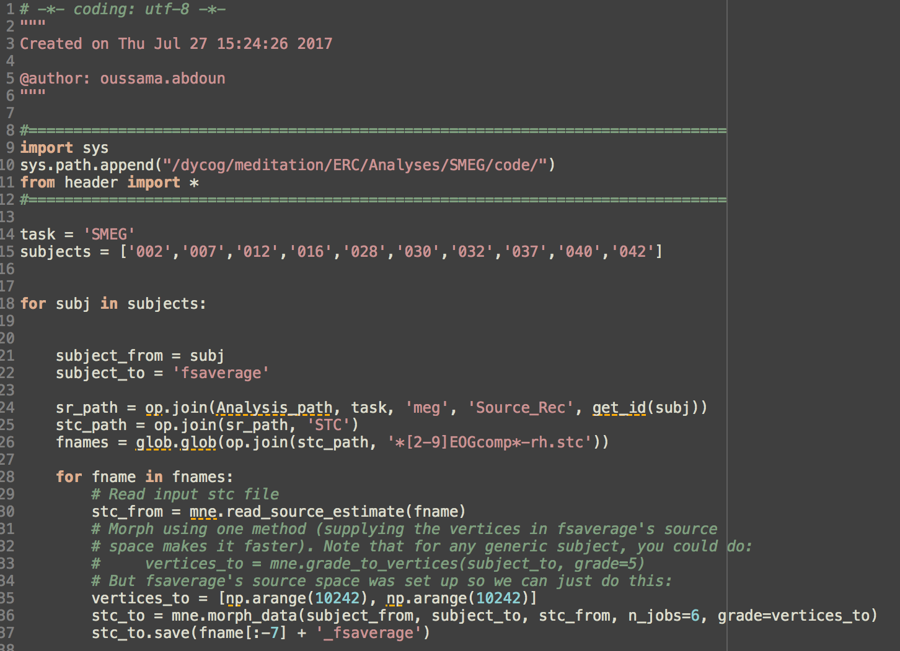
6. Morphing to an average brain (fsaverage)
Open « morphing_stc.py »
Specify task and subjects as usual.
Run the script.
You should now have a duplicate ‘_fsaverage-rh.stc’ and ‘_fsaverage-lh.stc’ for each source estimate file you processed.
« morphing_stc.py »

Slide 11
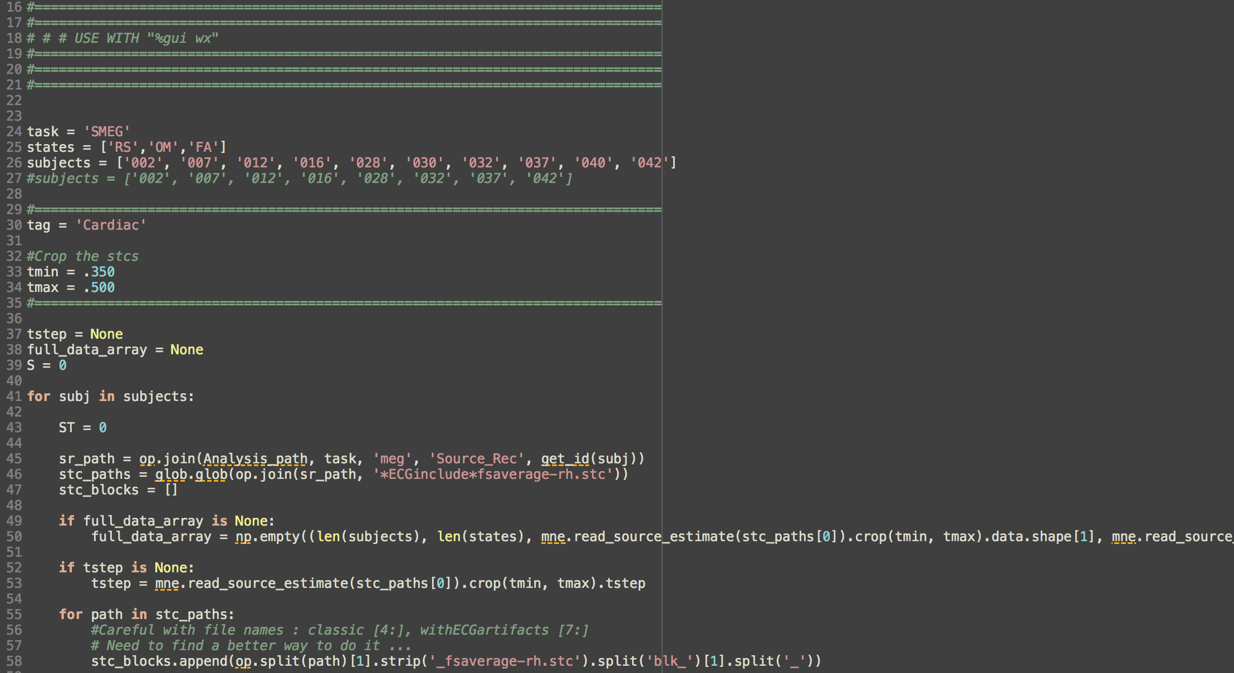
7. Statistics : spatio-temporal cluster test on fsaverage morphed source estimates
Open « spatio_temp_cluster_test.py »
Execute the command line ‘%gui wx’ in the console.
Specify task, states, subjects, tag.
Crop the source estimates if need using tmin and tmax variables.
Towards the bottom of the script, specify n_permutations and p_threshold for the cluster statistics.
Run the script.
Save if needed (this part needs rewriting).
« spatio_temp_cluster_test.py »
« spatio_temporal_cluster_1samp_10000_0.001_OM-RS.png »

